Slide 1


Leicester De Montfort Law School
Lecture 2 Part 3
Civil Litigation – Commencing Proceedings

Slide 2
Which Court?
Civil litigation claims are generally issued at the County Court or at the High Court.
Claims that are valued over £100,000 (or over £50,000 if it is a PI or CN claim) should be issued at the High Court.
Claims below the above values should be issued at the County Court.
When calculating the value of a claim the following should be disregarded:
  Interest
  Costs
  Potential contributory negligence
  Potential counterclaims/setoffs

Slide 3
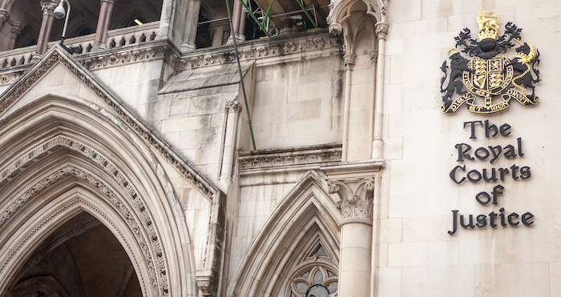
The High Court
The High Court has three divisions:
  Family Division
  Chancery Division
  Kings Bench Division

Slide 4
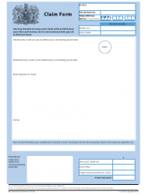
Commencing Proceedings
To commence proceedings a claim form needs to be completed and submitted. In most cases this will be a form N1.
CPR 16.2 sets out the contents of the claim form and other statements of case.
The claim form sets out:
  Court – HC or CC
  Parties – names and addresses
  Brief details of claim and remedy sought
  Statement of value
  Particulars of claim
  Statement of truth
  Fees and costs.

Slide 6
Parties to the Proceedings
The parties may be:
  Individuals: sue/are sued in their own name provided that they are over 18 and are of sound mind.
  Partnerships: sue/are sued either in the firm’s name or by naming the individual partners.
  Sole Traders: sue/ are sued in the business owners name, or the business owners name t/a business name.
  Companies : sue/are sued in the company name.

Slide 7
Litigation Friend
A child or a protected party must have a litigation friend to conduct proceedings on their behalf under CPR 21.2.
A child means a party that is under the age of 18.
A protected party means a party that lacks mental capacity to conduct the proceedings.
The litigation friend will usually be a parent, guardian or a person appointed under Mental Health Act 2005.

Slide 8
Litigation Friend continued
A litigation friend must file and serve a certificate of suitability which states that the litigation friend:
  consents to act
  knows or believes that the party is a child/ lacks capacity to conduct the proceedings
  in the case of a party wo lacks capacity (more commonly referred to as a protected party), the grounds of his belief and if his belief is based upon a qualified expert
  can fairly and competently conduct proceedings and has no adverse interest
  undertakes to pay costs.

Slide 9

Statement of Value
A statement of value must be provided as per CPR 16.3.
The purpose is to enable the court to allocate the case to appropriate track
Statement must:
  Specify the precise amount claimed( including interest) or
  Indicate whether the claimant expects to recover:
    Not more than £10000
    Between £10000 and £25000
    More than £25000
  The above needs to be read in conjunction with any other rule or court form guidance.

Slide 10

Statements of Truth
The rules governing statements of truth are set out in CPR 22.
Where the statement of truth is signed by the client (which is best practice):
I believe that the facts stated in this [name document] are true. I understand that proceedings for contempt of court may be brought against anyone who makes, or causes to be made, a false statement in a document verified by a statement of truth without an honest belief in its truth.
Where the statement of truth is signed by the legal advisor:
The [name of party] believes that the facts stated in this [name document] are true. I understand that proceedings for contempt of court may be brought against anyone who makes, or causes to be made, a false statement in a document verified by a statement of truth without an honest belief in its truth.

Slide 11
Particulars of Claim
There is no set length of a particulars of claim. In simple straight forward matters they will be short, in very complex commercial matters they will be a number of pages.
The particulars of claim can be contained within or attached to claim form or served within 14 days of claim form being served.
The particulars of claim and claim form constitutes the claimant’s statement of case.

Slide 12
Issuing Proceedings
Copies of claim form and particulars of claim are posted to the court with the relevant court fee.
The following may also need to be sent to the court with the claim form and particulars of claim:
  Legal aid certificate
  Suitability certificate
  Medical report(s) and a schedule of loss.
The court issues the documents.
Service is usually by the court by 1st class post.

Slide 13

Service of Documents
CPR 6 sets out the:
  Methods of serving documents
  Possible places for service
  The parties to be served
  Deemed dates of service

